Slide 1
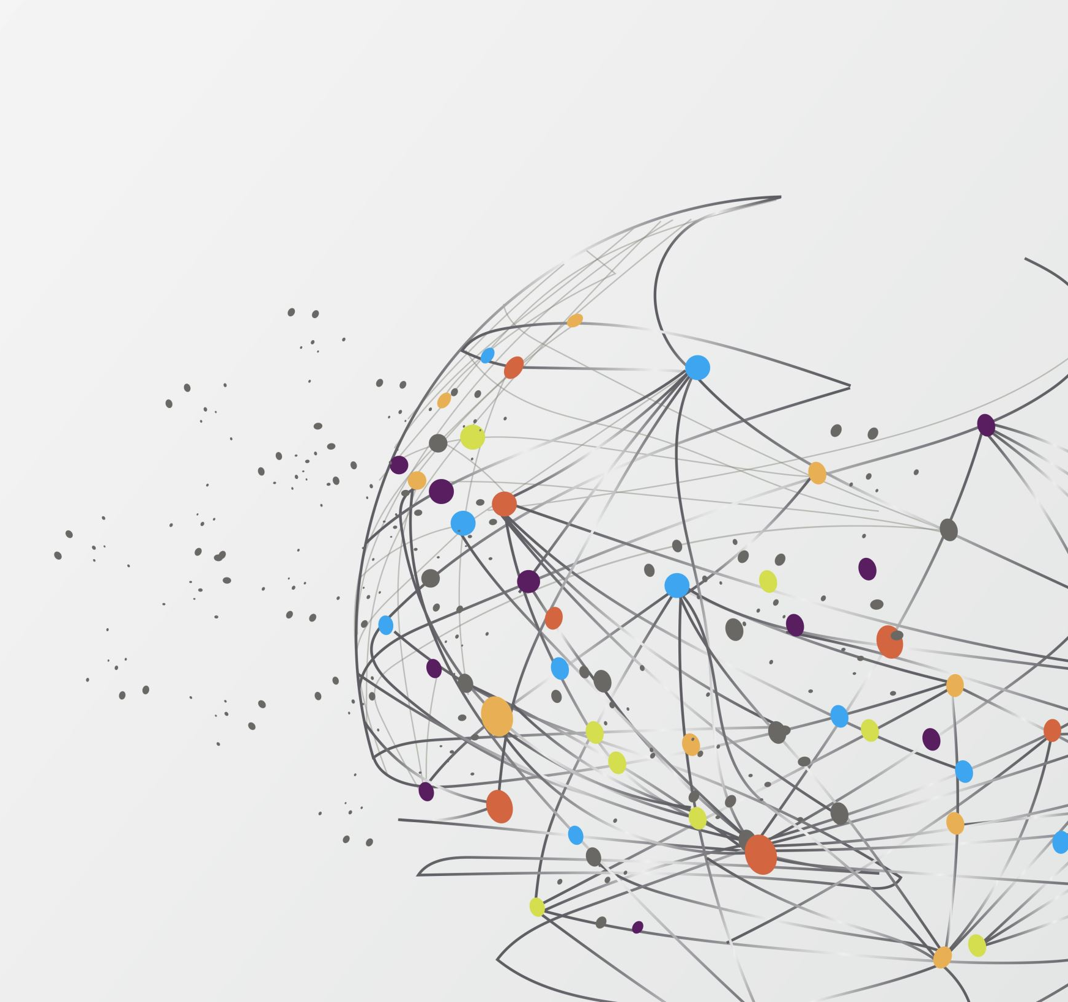
Generative AI for
Predictive Maintenance
Vibrational Time Series
Jon Chun
Integrated Program in Humane Studies
Founding Co-Director, KDH Lab and Human-Centered AI Curriculum
Affiliated Faculty, Kenyon College Computing

Slide 2
Agenda
Big Picture
ML Time Series Challenges
Why Deep Learning?
Vibrational Analysis for Predictive Maintenance
Can LLM Understand?
Time Series Augmentation
SOTA Research
References: https://github.com/jon-chun/nafems-anomalous-time-series-augmentation/

Slide 3
Spherical Cows in the Room
Predict/Forecast > Analyze > Augment > Synthesize
No: real-time constraints
No: multi-variable
No: irregular sampling & lengths (DTW)
Yes: Clean, consistent, complete time series
Yes: Narrow single domain
Yes: Single, open API vendor
Condensed Talk

Slide 4
Challenges of Univariable Time Series
Long-range Dependencies
High-dimensions -> multicollinearity
low S/N(non-gaussian)
Non-stationarity
Complex, non-linear, feedback loops
Irreversible composition (freq overlap)

Slide 5
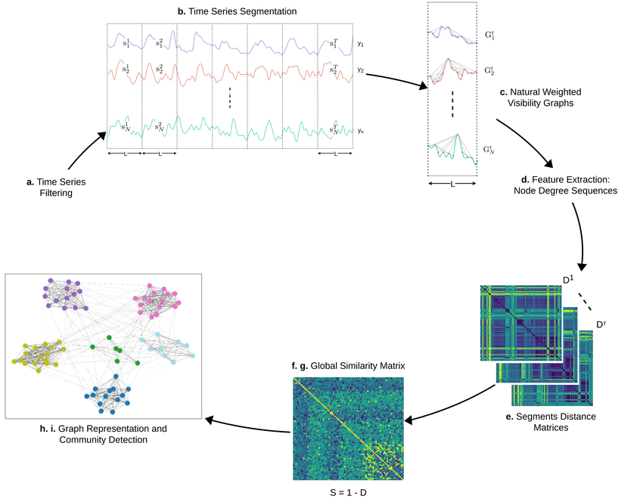
Statistical ML (GOFAI)

Slide 6
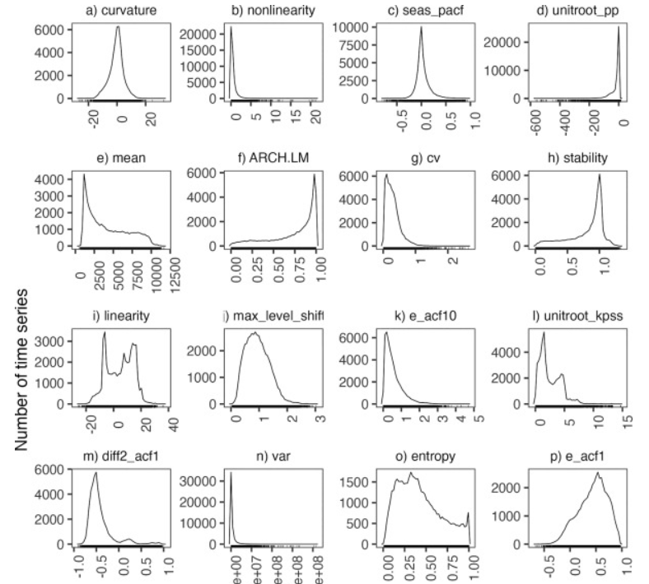
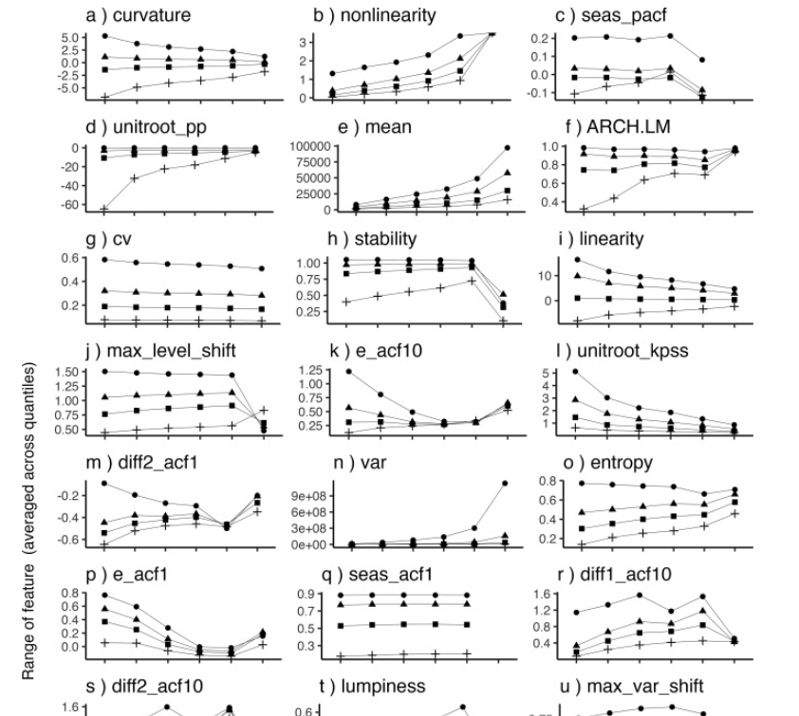
M4 Competition (100k)
Exploring the association between time series features and forecasting by temporal aggregation using machine learning, Rostami-Taber (1 Sep 2023)
Notes:
Exploring the association between time series features and forecasting by temporal aggregation using machine learning - ScienceDirect

Slide 7
Deep Learning (VAE, GAN, LLM, EBM+)
Universal F(x) Approximators
No Feature Engineering*
Rapid Progress
Model Proliferation
Cost/Performance
Context Window
Tooling, Enterprise Integration, & Agents
LLM -> Foundational Models
Fine-tune Open: 10x + Private
Smaller, high-quality Data
Synthetic Data Gold Rush
Specialized Models + MoE

Slide 8
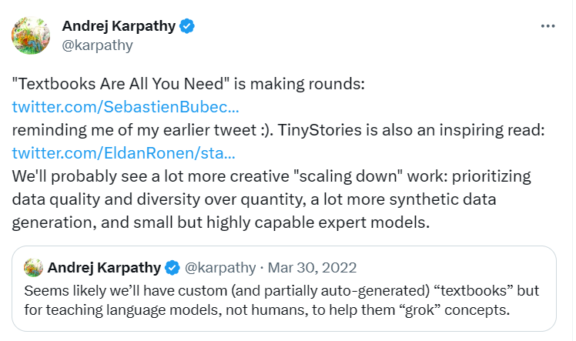
Training Datasets: Quality > Quantity
Notes:
(15) Andrej Karpathy on X: ""Textbooks Are All You Need" is making rounds: https://t.co/TVdsiTsS2B reminding me of my earlier tweet :). TinyStories is also an inspiring read: https://t.co/iULz3UHi0E We'll probably see a lot more creative "scaling down" work: prioritizing data quality and diversity over…" / X (twitter.com)

Slide 9
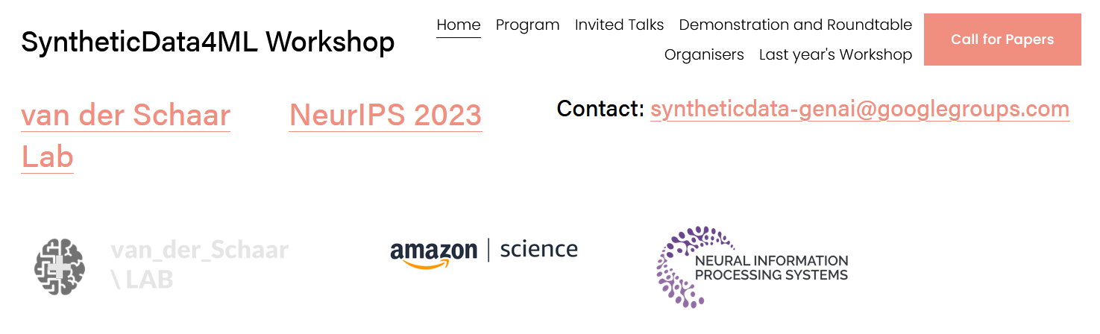
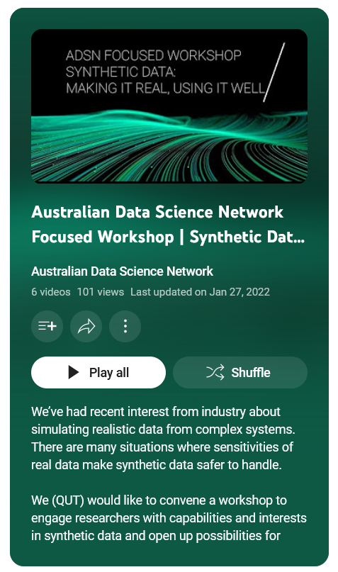
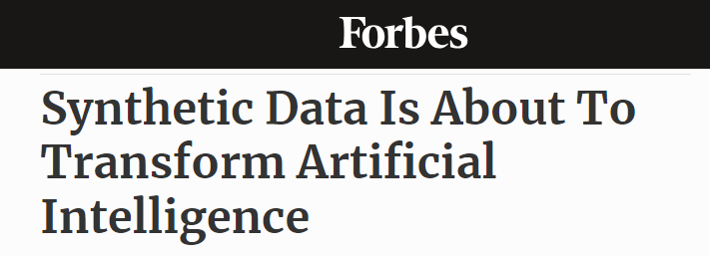
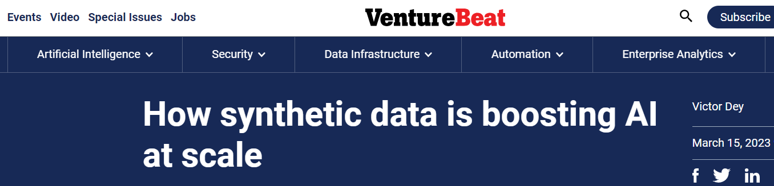
Notes:
https://www.syntheticdata4ml.vanderschaar-lab.com/
https://www.youtube.com/playlist?list=PL5yIxhVj46z1bvmE6VeaobSQChtFIw4fd
https://www.gartner.com/en/articles/take-this-view-to-assess-roi-for-generative-ai
https://venturebeat.com/ai/synthetic-data-to-boost-ai-at-scale/
https://www.forbes.com/sites/robtoews/2022/06/12/synthetic-data-is-about-to-transform-artificial-intelligence/?sh=1b49808c7523

Slide 10
Bearing Vibration
Time Series
Data Synthesis

Slide 11

Motivation
PdM Vibrational Analysis
+40% catastrophic failures
Few open datasets: costly, experts, trade secrets
Unbalanced/rare anomalies
Fuzzy boundaries
Desired Properties
Fidelity: ID performance
Diverse: OOD generalization
Autoregressive: Preserve temporal correlations
Multi-fractal: Multiscale across multiple domains
Notes:
https://engineering.case.edu/bearingdatacenter

Slide 12
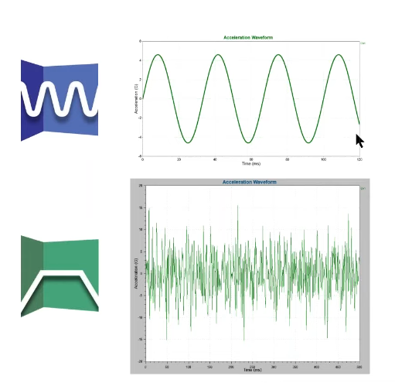
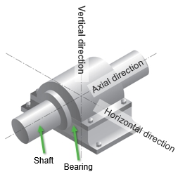
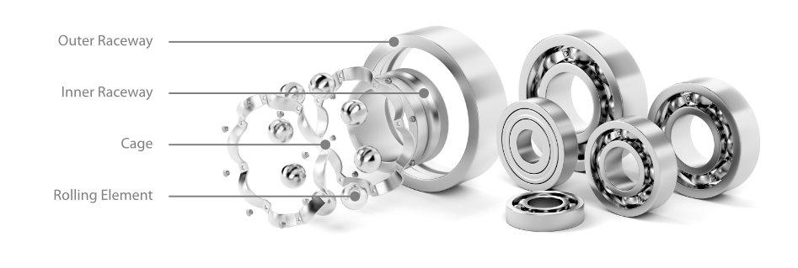
Notes:
https://ncd.io/blog/bearing-fault-detection-vibration-analysis/#:~:text=Vibration%20analysis%20is%20a%20widely,issues%2C%20such%20as%20bearing%20faults

Slide 13
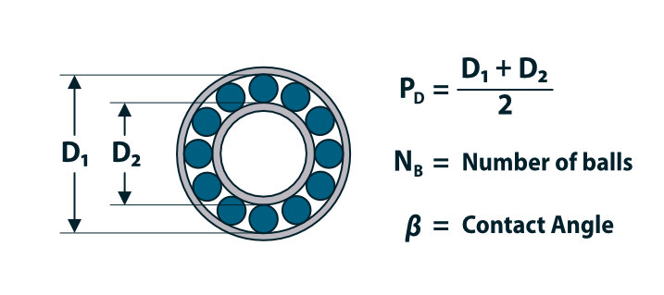
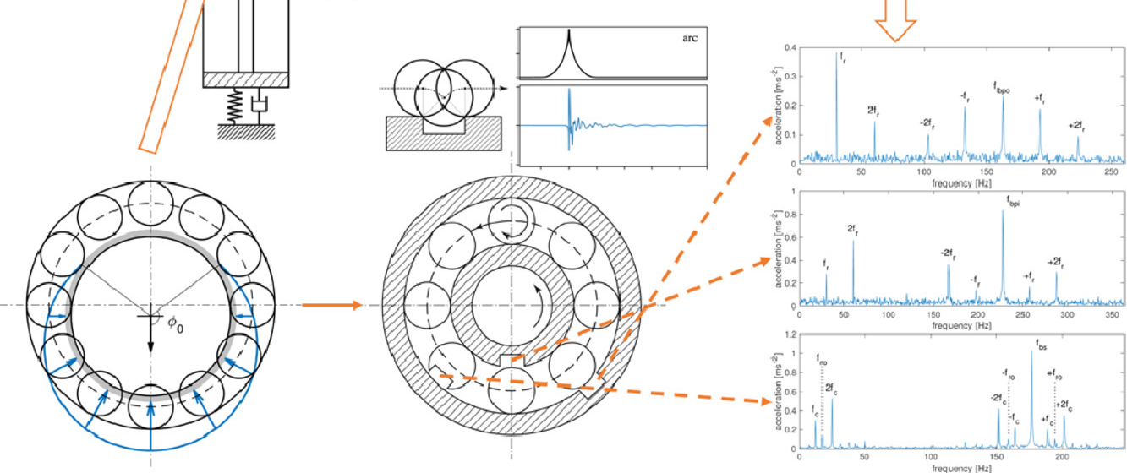
Non-Deterministic / Aperiodic
Stationary vs non-Stationary
Linear vs non-Linear
Interactions / Feedback
Notes:
https://ncd.io/blog/bearing-fault-detection-vibration-analysis/#:~:text=Vibration%20analysis%20is%20a%20widely,issues%2C%20such%20as%20bearing%20faults

Slide 14
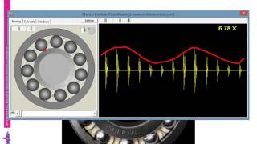

Slide 15
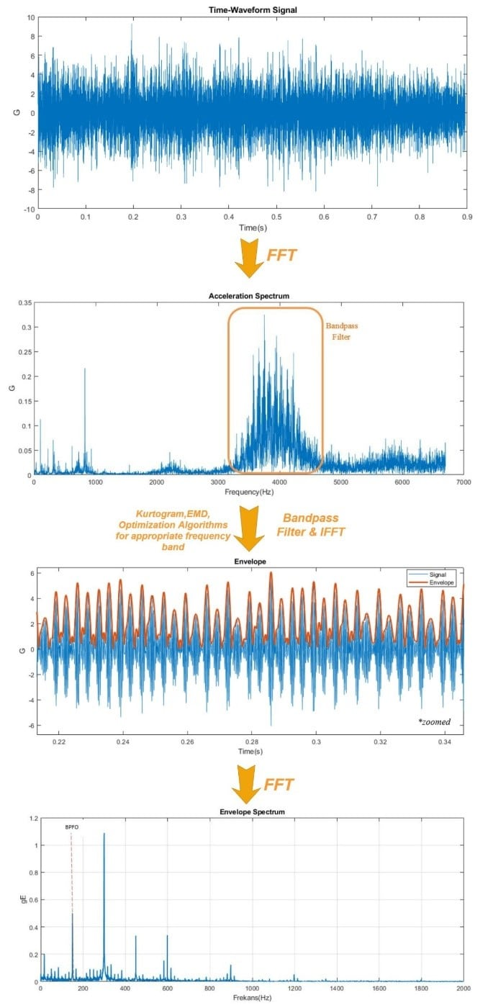
Notes:
https://sensemore.io/envelope-analysis/#:~:text=Envelope%20analysis%2C%20sometimes%20referred%20to,frictional%20forces%20produced%20by%20bearings

Slide 16
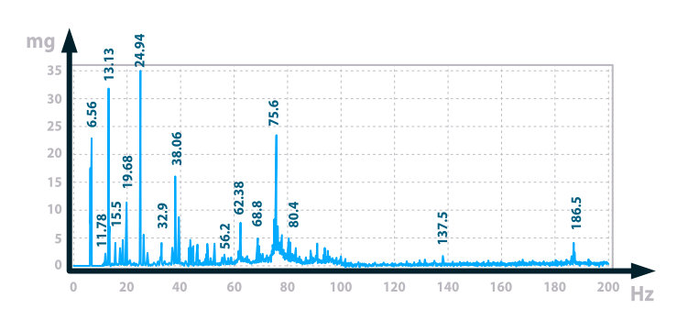
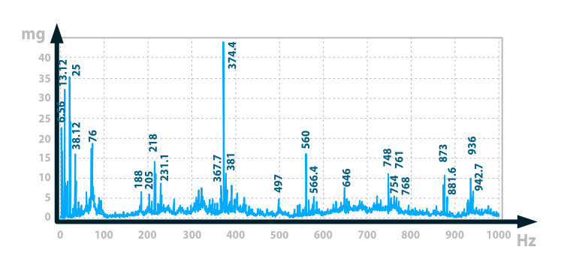
Roller Failure:
Snapshot
There is vibration at 62.4Hz which is 2x the roller rotational frequency, more interestingly there are harmonics at 186.5(x3), 497(x8), 560(x9), 748(x12), 873(x14) and 936Hz (x15). This indicates deterioration in the condition of the rollers.

Slide 17
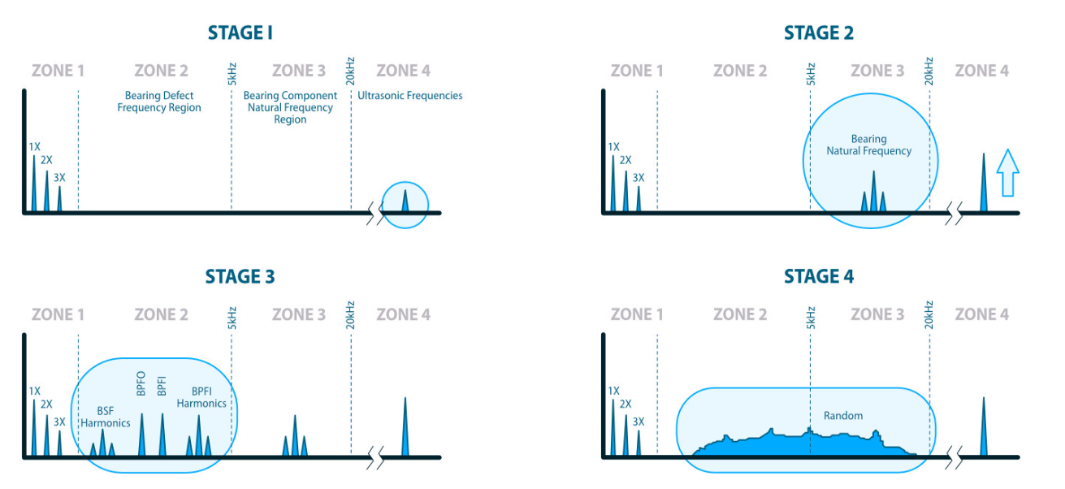
Roller Failure: Evolution
Notes:
https://ncd.io/blog/bearing-fault-detection-vibration-analysis/#:~:text=Vibration%20analysis%20is%20a%20widely,issues%2C%20such%20as%20bearing%20faults

Slide 18
Deep Learning
LLMs &
Foundational Models
Data Synthesis

Slide 19
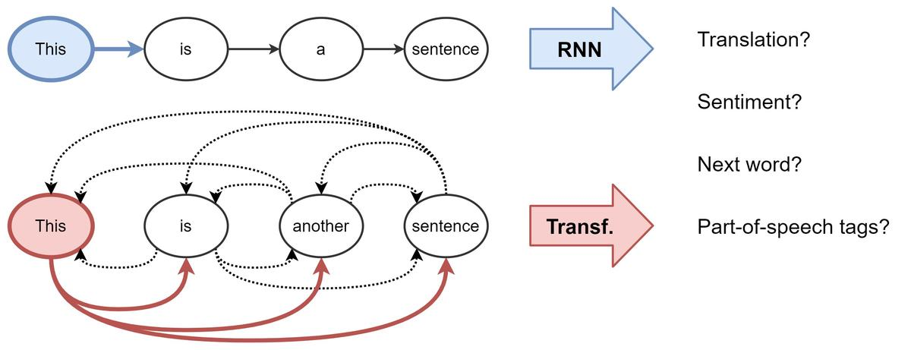
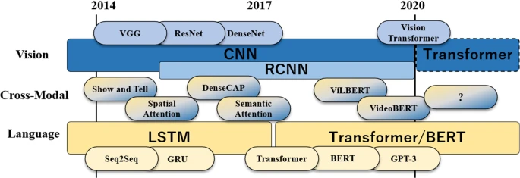
Why Transformers:
Long-range dependencies
(Training) Vanishing Gradient
(Inference) Attention Mechanism
Parallel processing
Scale Training/Core Abilities
Emergent Abilities
Notes:
Do Transformers Lose to Linear Models? | by Nakul Upadhya | Towards Data Science
[2205.13504] Are Transformers Effective for Time Series Forecasting? (arxiv.org)
yuqinie98/PatchTST: An offical implementation of PatchTST: "A Time Series is Worth 64 Words: Long-term Forecasting with Transformers." (ICLR 2023) https://arxiv.org/abs/2211.14730 (github.com)
[2211.14730] A Time Series is Worth 64 Words: Long-term Forecasting with Transformers (arxiv.org)

Slide 20
LLM to Multimodal Foundational Models
Pros
Progress: Entire Stack
Discoveries: Algos/Training
Tool Use/Creation
Complemented (DB, KB)
Reasoning Agents
Emergent Abilities
Cons
Innumeracy (Language)
Hallucinations
Stochastic > Deterministic
Limited Context Window
Cost/Complexity vs GOFAI
Big(ger) Data
Stochastic Parrot (no model or real understanding)

Slide 21
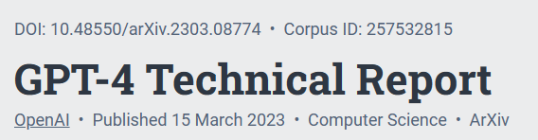
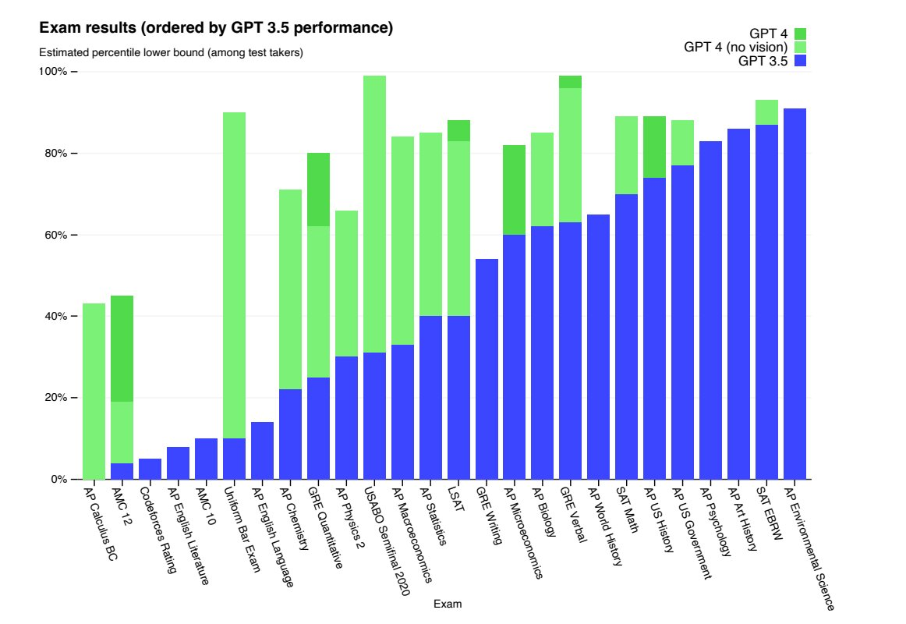
Notes:
https://arxiv.org/abs/2303.08774

Slide 22
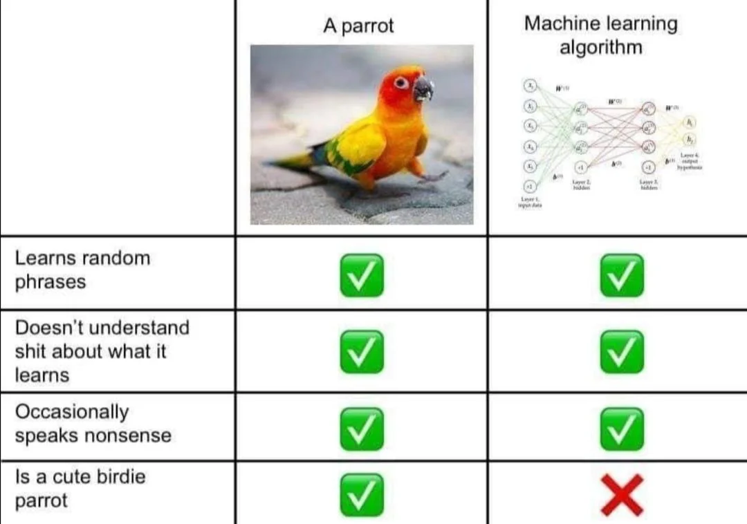

Slide 23
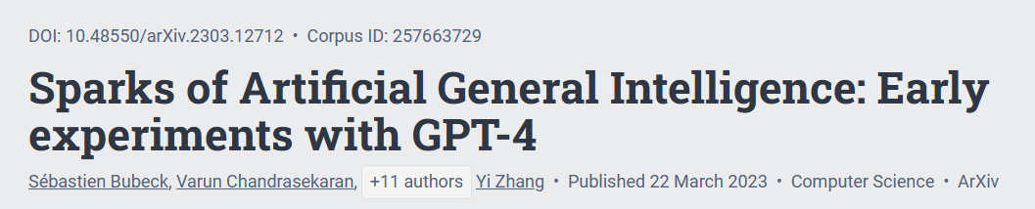
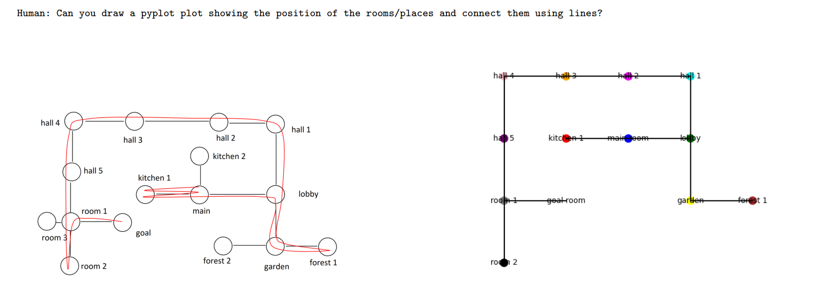
Notes:
https://arxiv.org/pdf/2303.12712.pdf

Slide 24
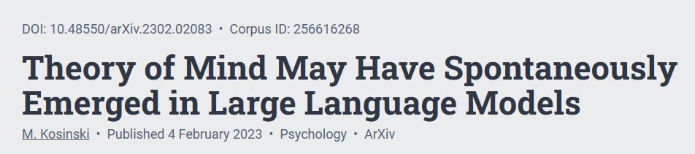
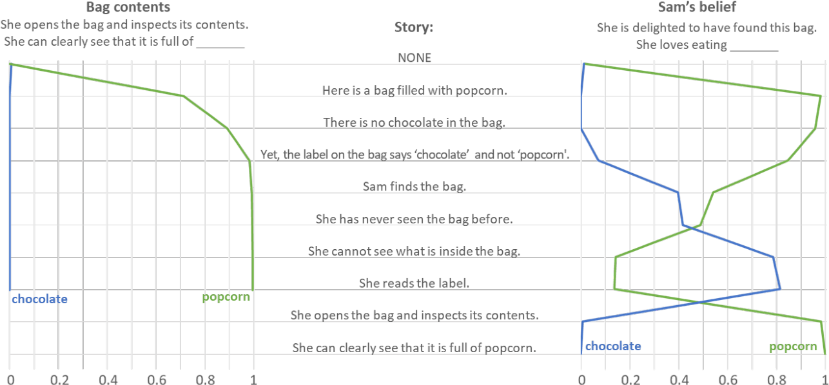
Notes:
https://arxiv.org/ftp/arxiv/papers/2302/2302.02083.pdf
(62) Theory of Mind in Large Language Models: A Response to Whang, Sap, and Ullman | LinkedIn
[PDF] Theory of Mind May Have Spontaneously Emerged in Large Language Models | Semantic Scholar

Slide 25
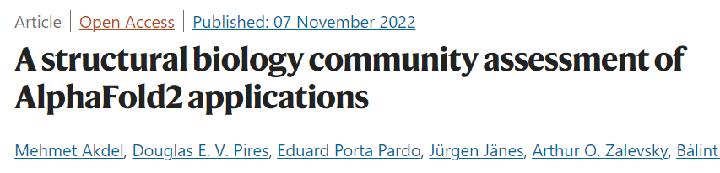
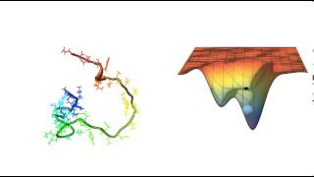
3B ATCG Sequence -> Human
Notes:
https://www.nature.com/articles/s41594-022-00849-w
https://www.deepmind.com/blog/alphafold-a-solution-to-a-50-year-old-grand-challenge-in-biology

Slide 26
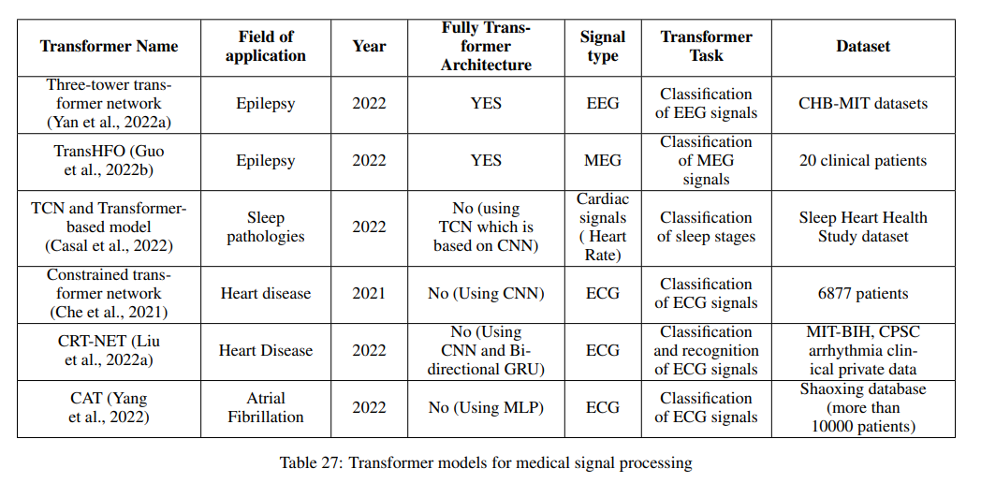
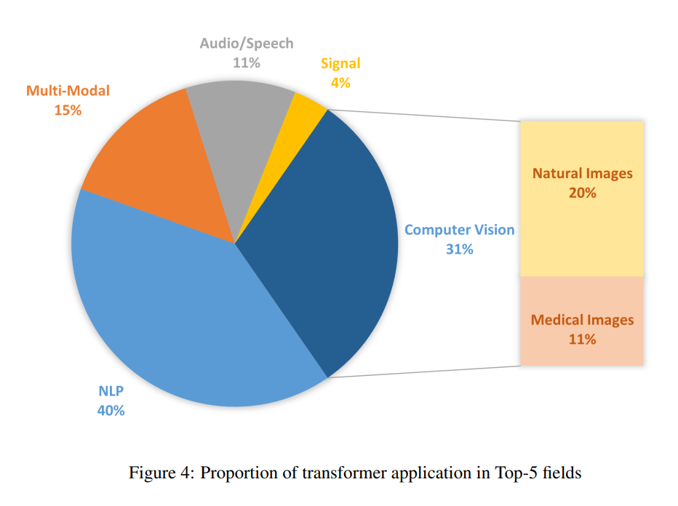
Under Explored
Notes:
https://www.deepmind.com/blog/alphafold-a-solution-to-a-50-year-old-grand-challenge-in-biology

Slide 27
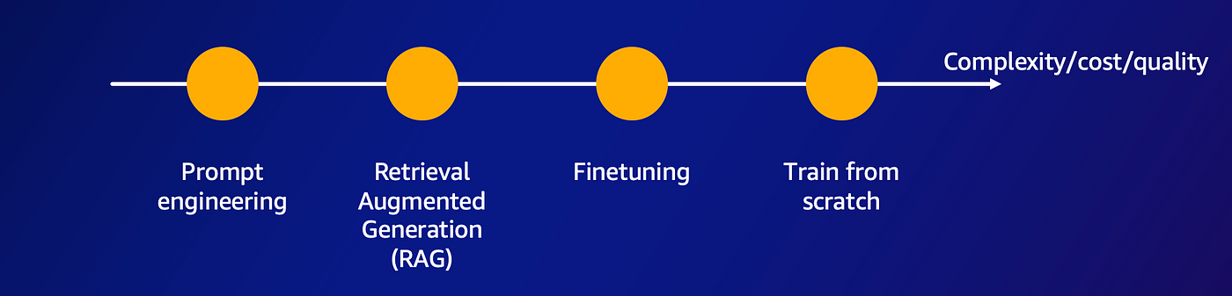
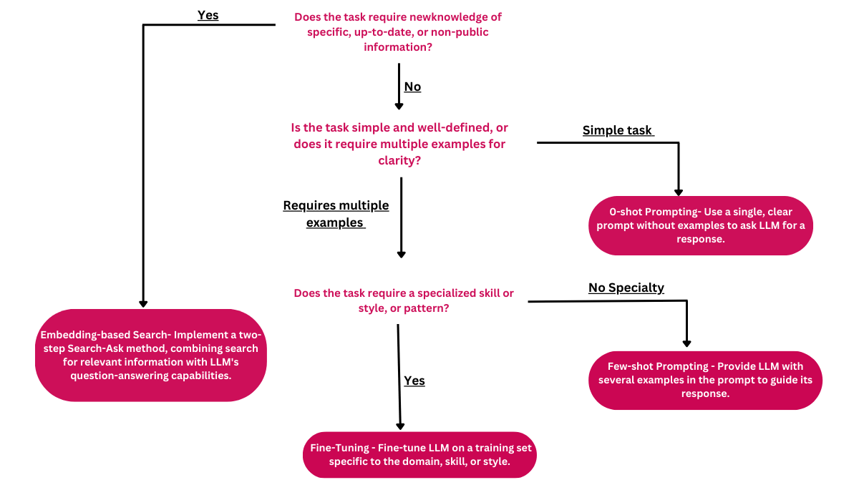
How LLMs Learn
Notes:
Do Transformers Lose to Linear Models? | by Nakul Upadhya | Towards Data Science
[2205.13504] Are Transformers Effective for Time Series Forecasting? (arxiv.org)
yuqinie98/PatchTST: An offical implementation of PatchTST: "A Time Series is Worth 64 Words: Long-term Forecasting with Transformers." (ICLR 2023) https://arxiv.org/abs/2211.14730 (github.com)
[2211.14730] A Time Series is Worth 64 Words: Long-term Forecasting with Transformers (arxiv.org)

Slide 28
LLM Datasets: Quality > Quantity
Notes:
(15) Andrej Karpathy on X: ""Textbooks Are All You Need" is making rounds: https://t.co/TVdsiTsS2B reminding me of my earlier tweet :). TinyStories is also an inspiring read: https://t.co/iULz3UHi0E We'll probably see a lot more creative "scaling down" work: prioritizing data quality and diversity over…" / X (twitter.com)

Slide 29
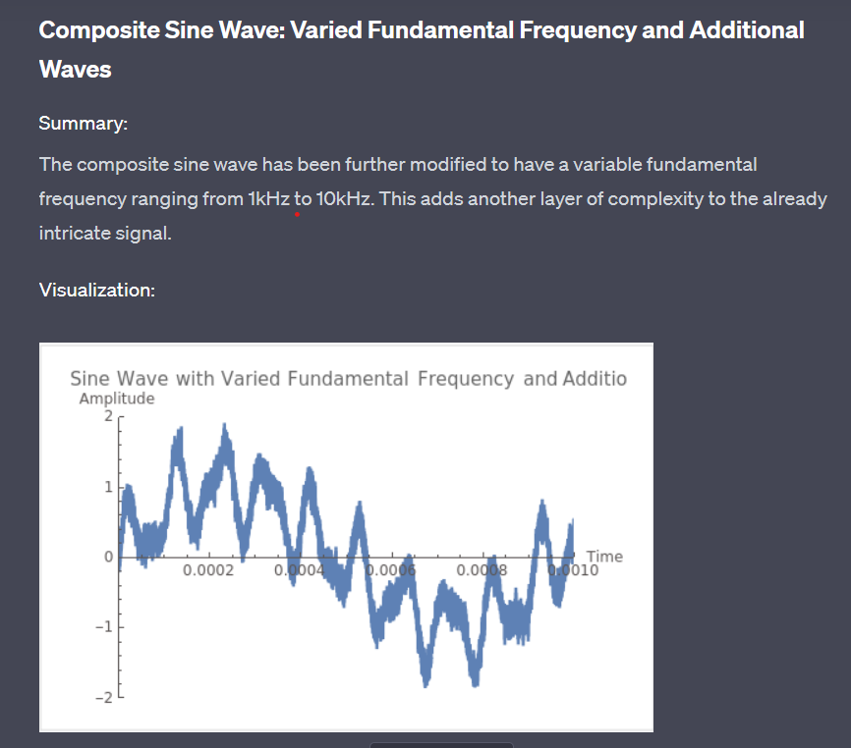
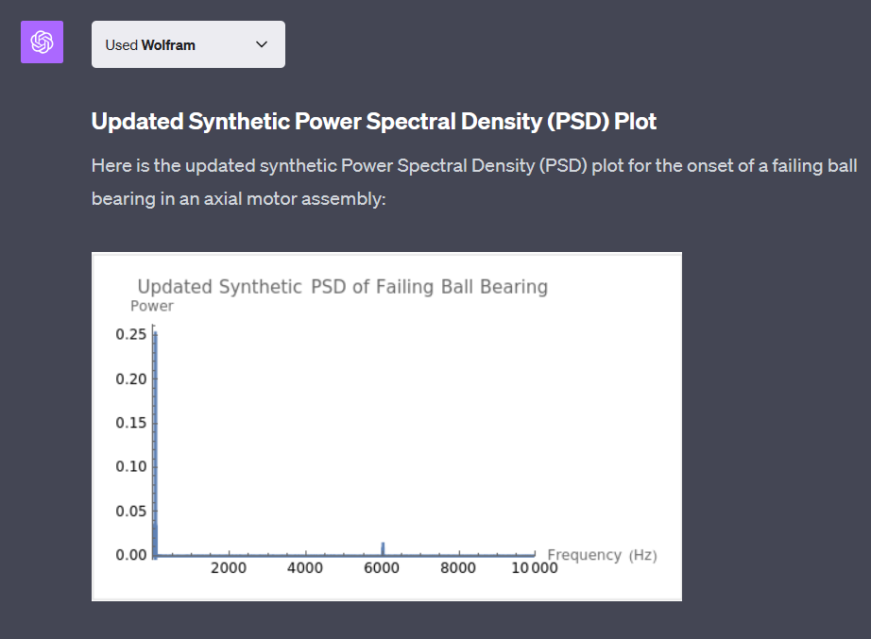
Notes:
5kHz Amplitude 1 Sine Wave (openai.com)
Failing Bearing PSD Characteristics (openai.com)

Slide 30
Time Series Augmentation
Data Synthesis

Slide 31
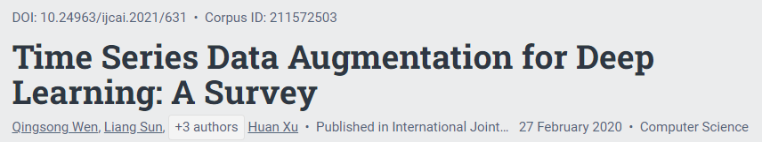
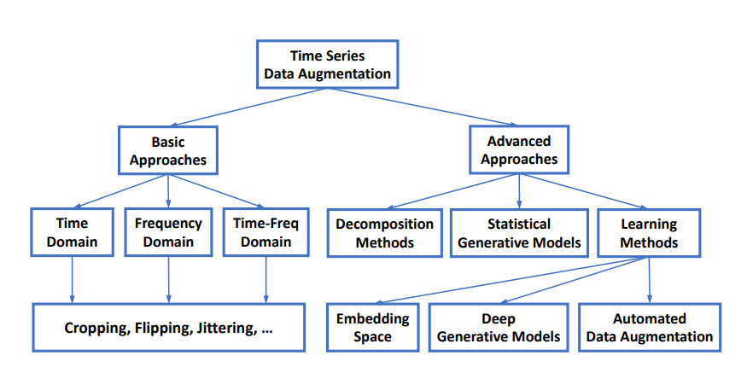
Time Series Data Augmentation for Deep Learning: A Survey by Qingsong Wen et al. Mar 31, 2022
Notes:
https://arxiv.org/pdf/2002.12478.pdf

Slide 32
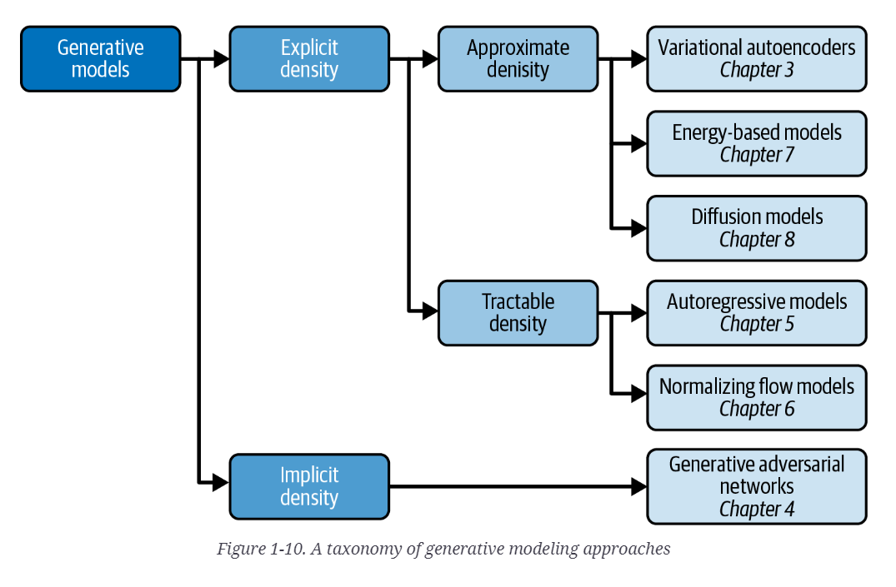
Generative Deep Learning: Teaching Machines To Paint, Write, Compose, and Play 2nd Edition by David Foster (Jun 2023)
Notes:
https://www.amazon.com/Generative-Deep-Learning-Teaching-Machines/dp/1098134184/ref=sr_1_1?crid=3U9VNY3Y5P8BW&keywords=generative+deep+learning%2C+2nd&qid=1694965273&sprefix=generative+deep+learning%2C+2nd%2Caps%2C82&sr=8-1

Slide 33
Practical Time Series
Generation & Benchmarks
Data Synthesis

Slide 34
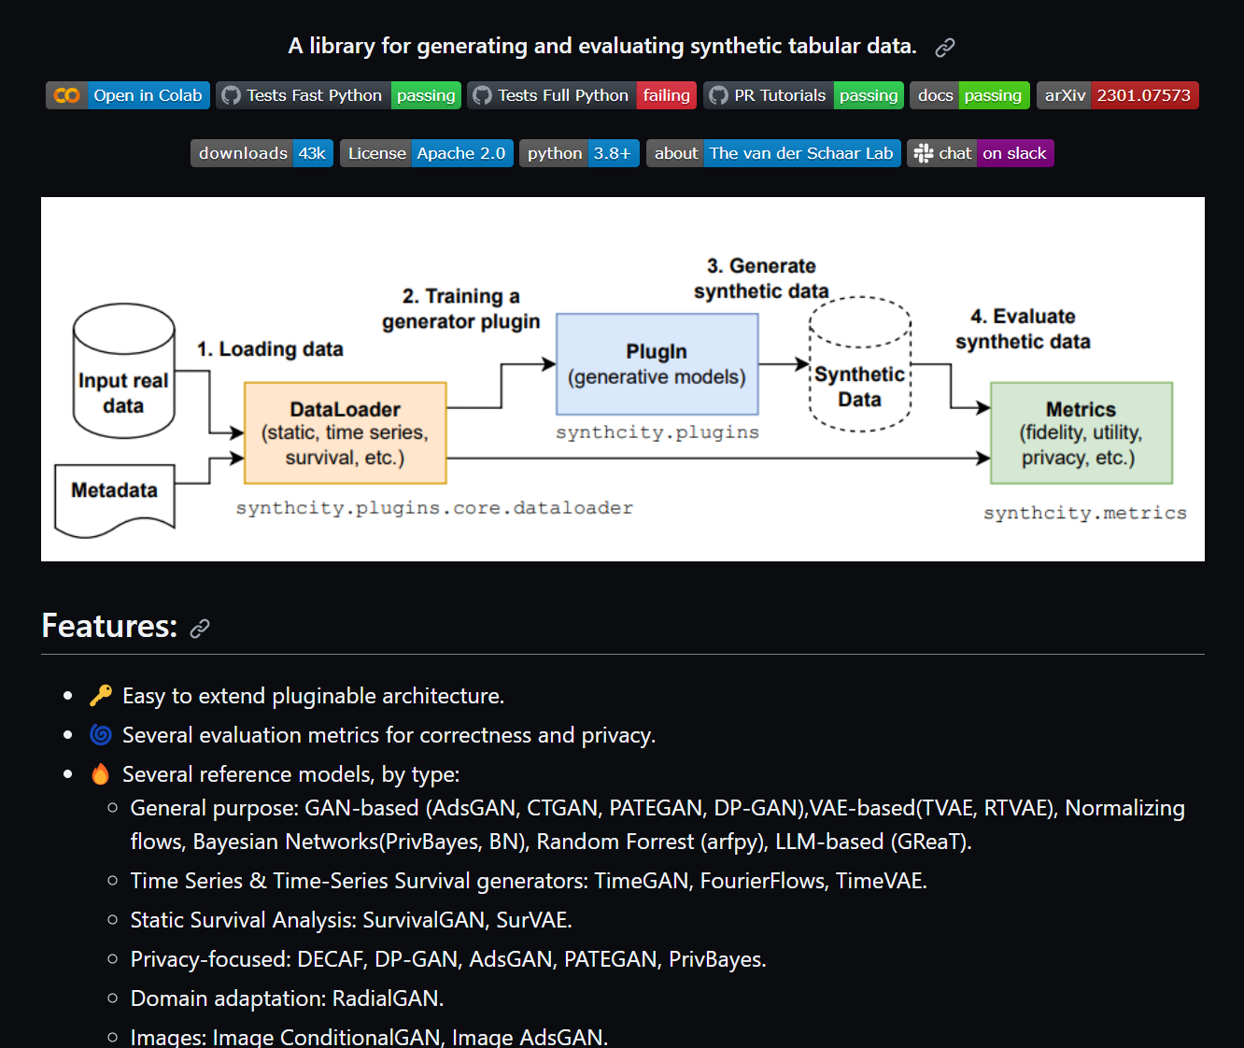
Synthcity:
Github (20230912) vanderschaarlab/synthcity: A library for generating and evaluating synthetic tabular data for privacy, fairness and data augmentation. (github.com)
Notes:
Github (20230912) vanderschaarlab/synthcity: A library for generating and evaluating synthetic tabular data for privacy, fairness and data augmentation. (github.com)

Slide 35
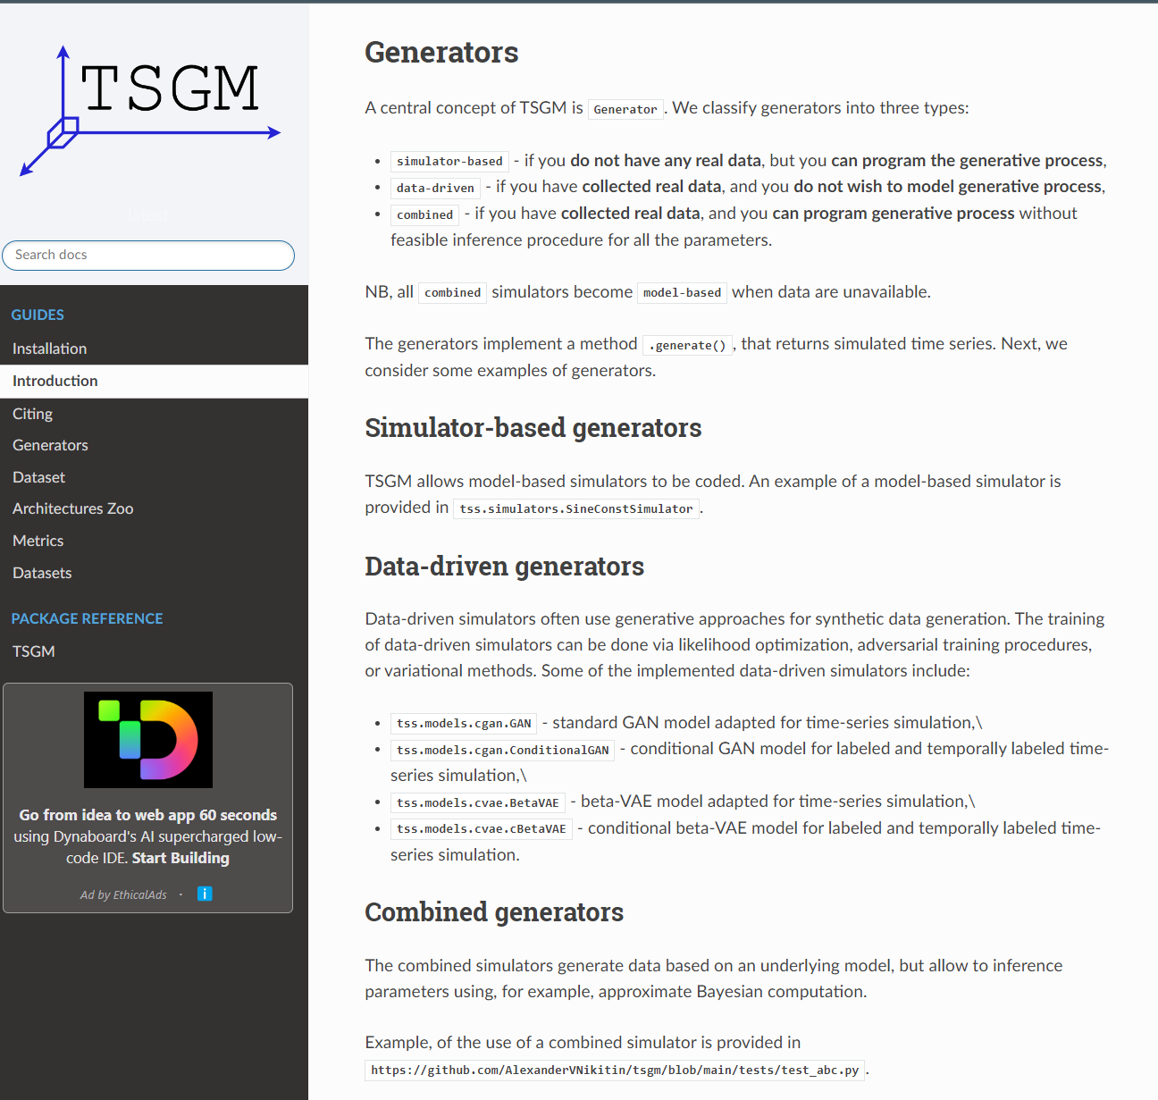
TSGM:
Github (20230918) AlexanderVNikitin/tsgm: Generative modeling of synthetic time series data and time series augmentations (github.com)
Documentation (pypi) Time Series Simulator (TSGM) Official Documentation — tsgm 0.0.0 documentation
Colab: Getting started with TSGM.ipynb - Colaboratory (google.com)
Notes:
AlexanderVNikitin/tsgm: Generative modeling of synthetic time series data and time series augmentations (github.com)

Slide 36
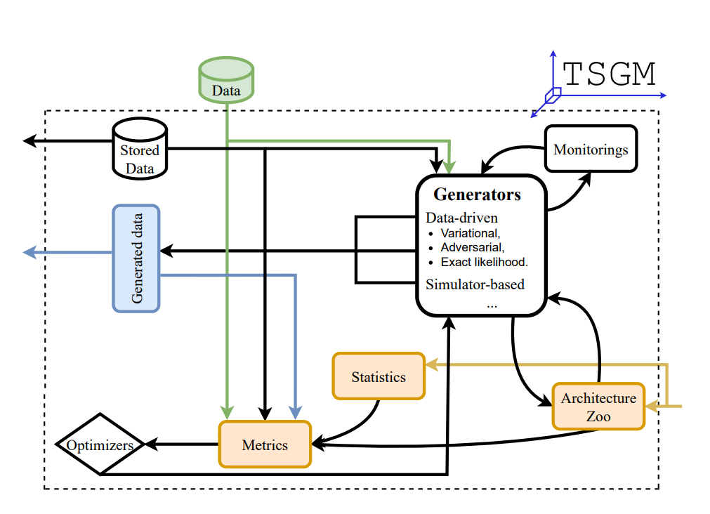
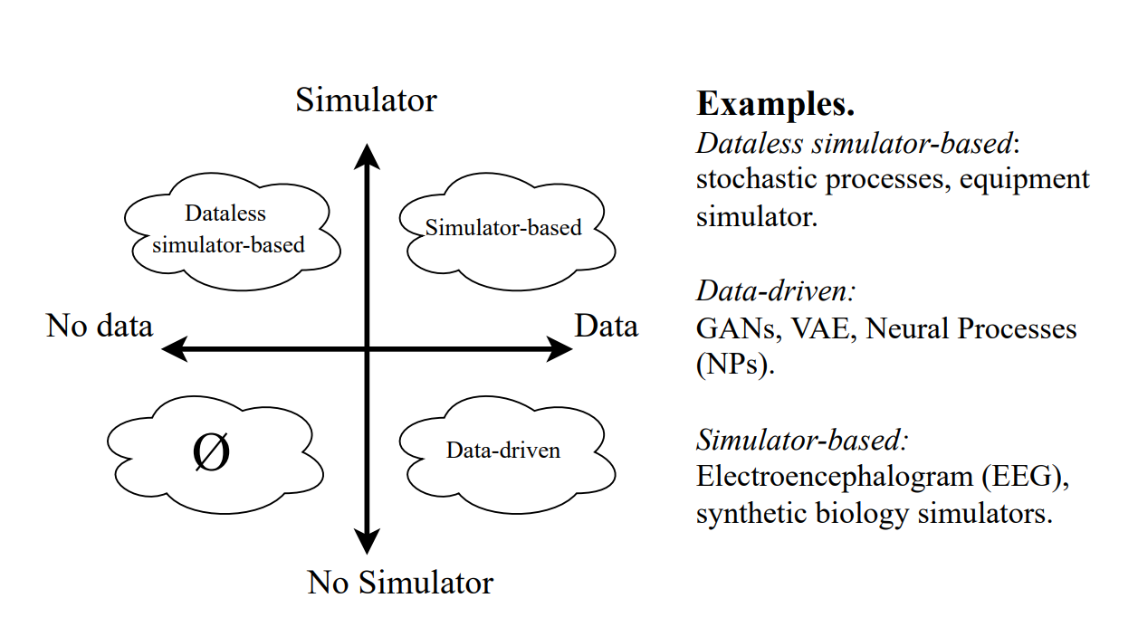
TSCM:
Notes:
AlexanderVNikitin/tsgm: Generative modeling of synthetic time series data and time series augmentations (github.com)

Slide 37
Time Series Generative Model (TSCM)
TS: Conditioned and temporally conditioned time series
Models: Generative, Probabilistic, Simulator
Classes:
* Data-Driven: GAN, VAE and Neural Processes (NP)
Dataless: Generative user-specified model (ARIMA?)
* Simulator: est model param from data (Gaussian Processes, Bayesian)
Metric Types: Similarity, downstream task, predictive consistency, fairness, privacy, diversity, and visual comparison
Goal
Complex interdependencies
unlabeled, labeled and temporally labeled
Results
NASA C-MAPPS: train 1100x(24) & UCI Energy 1000x(16)
Notes:
AlexanderVNikitin/tsgm: Generative modeling of synthetic time series data and time series augmentations (github.com)

Slide 38
SOTA Time Series
Generation Research
Data Synthesis

Slide 39
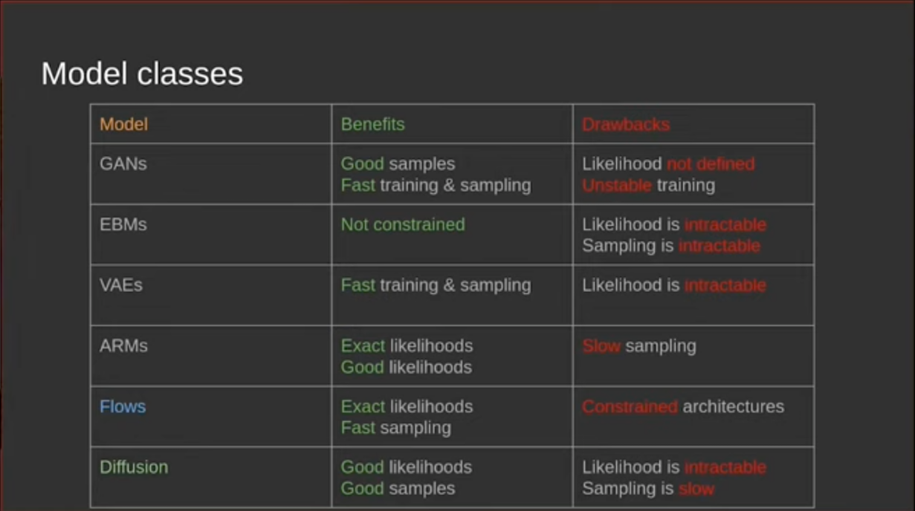

Slide 40
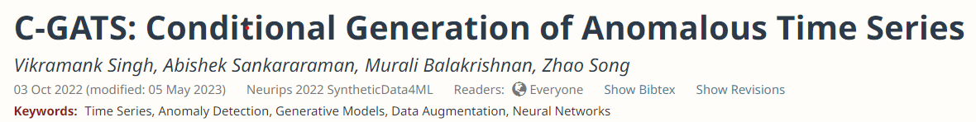
C-GATS (5 May 2023)
Factorize the anomalous time series into 3 subsequences (normal, anomalous, and anomaly position/labels)
Train an unconditional VAE on just the normal samples
Then train a conditional generator to insert anomalies into the latent space based on the anomaly labels
Applying the labels at the end allows controlling anomaly position/type
Evaluation shows C-GATS generates diverse and label-preserving anomalies that improve multiple anomaly detection methods on various datasets.
Notes:
c-gats-conditional-generation-of-anomalous-time-series.pdf (amazon.science)
C-GATS: Conditional Generation of Anomalous Time Series | OpenReview
https://slideslive.com/embed/presentation/38993302

Slide 41
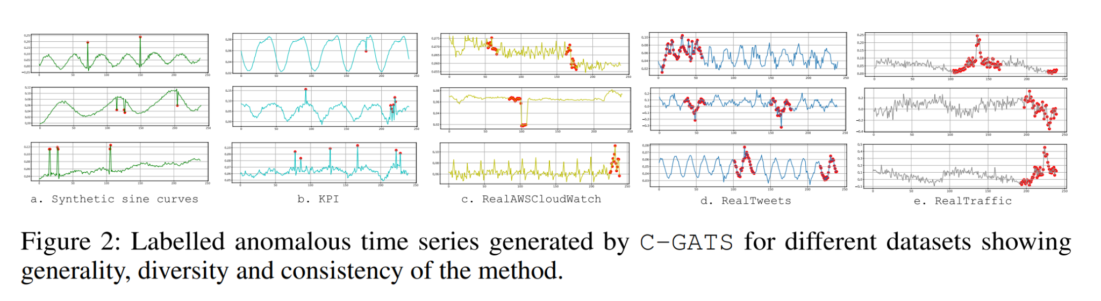
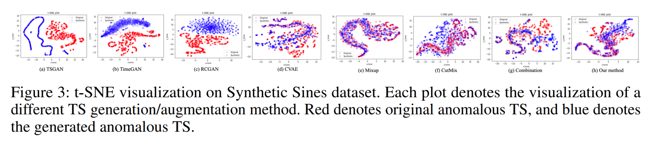
Notes:
c-gats-conditional-generation-of-anomalous-time-series.pdf (amazon.science)
C-GATS: Conditional Generation of Anomalous Time Series | OpenReview

Slide 42
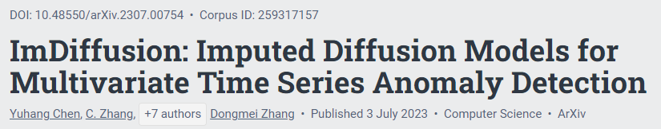
ImDiffusion (3 Jul 2023)
Use time series imputation as the prediction model, which leverages neighboring values as conditional information to better model temporal/inter-correlated dependencies.
Use unconditional diffusion models for imputation
Use a self-supervised grating masking strategy to intentionally create missing values for imputation
Leverage the multi-step outputs of the diffusion model's inference as an ensemble of signals to determine anomaly labels through voting
Experiments on 6 datasets show ImDiffusion outperforms 10 baselines in accuracy and timeliness. It achieved 11.4% higher F1 when deployed in Microsoft's email system.
Notes:
ImDiffusion: Imputed Diffusion Models for Multivariate Time Series Anomaly Detection (arxiv.org)

Slide 43
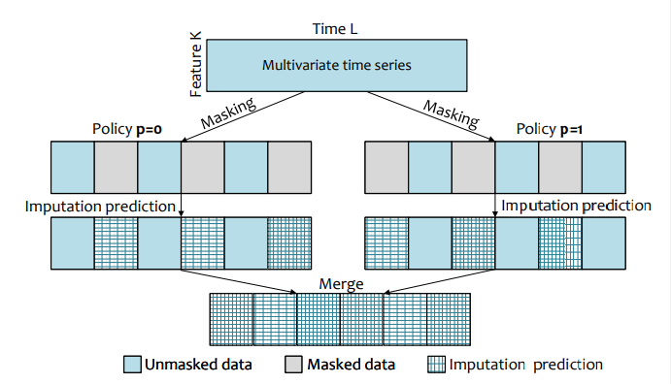
Notes:
c-gats-conditional-generation-of-anomalous-time-series.pdf (amazon.science)
C-GATS: Conditional Generation of Anomalous Time Series | OpenReview

Slide 44
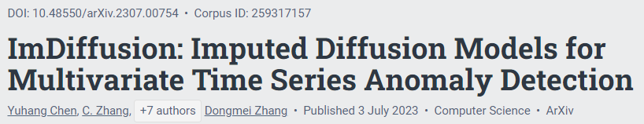
IH-TCGAN (5 May 2023)
New GAN for synthesizing multivariate time series data for intention recognition
Time-series conditional GAN (TCGAN) with a 1. transverter, 2. restorer, and 3. classifier to enable controlled generation of multiclass time series
Improved Hausdorff (IH) distance metric incorporating temporal order through a regularization term as the loss function
IH-TCGAN generates higher quality multiclass time series data than benchmarks like TimeGAN and GANs with other distance metrics
Notes:
ImDiffusion: Imputed Diffusion Models for Multivariate Time Series Anomaly Detection (arxiv.org)

Slide 45

TransFusion:
TransFusion = Diffusion Model + Transformer to synthesize long, high-quality multivariate time series
Transformers encoder in the diffusion model's backwards process to capture long-term temporal dependencies
Generates sequences up to length 384 (much longer than prior GAN and VAE)
Two new evaluation metrics using transformers: 1. a discriminative score to distinguish real/synthetic data, and 2. a predictive score for sequence forecasting
Experiments on 4 datasets: 1. higher fidelity data than benchmarks like TimeGAN, 2. higher diversity, and 3. less mode collapse
Visualizations and metrics demonstrate TransFusion's ability to generate realistic, diverse, long sequential data
Compared to GANs: slower sampling speed, but faster training
Notes:
https://arxiv.org/pdf/2307.12667.pdf

Slide 46
Survey of LLM Time Series
Data Synthesis

Slide 47


Frequency Domain
Notes:
A Survey on Deep Learning based Time Series Analysis with Frequency Transformation (arxiv.org)

Slide 48

Notes:
A Survey on Deep Learning based Time Series Analysis with Frequency Transformation (arxiv.org)

Slide 49
Time-Domain (point-wise correlations)
Intra-TS Correlations
(Sequential Models)
RNN
Temporal Conv Nets (TCN)
Transformer/Attention Heads
Inter-TS Correlation
(not opt for time domain)
CNN
Graph Neural Nets (GNN)
Notes:
A Survey on Deep Learning based Time Series Analysis with Frequency Transformation (arxiv.org)

Slide 50

Frequency-Domain (global correlations)
Intra-TS Correlations
Feature Extraction
Compression/Sparse
Data Augmentation (info loss)
Features
Periodicity
Multi-Scale
Global Dependencies/Rec Field
Explainability/Interpretability
Privacy
Notes:
A Survey on Deep Learning based Time Series Analysis with Frequency Transformation (arxiv.org)

Slide 51
Time-Domain (point-wise correlations)
Limitations
(FT Models)
Lost of temporal info
(eg aperiodic/linear)
Hyperparameter Optimization
window
sampling
frequency bands
Future
(not opt for time domain)
New Orthogonal Transforms
Legendre projection (polynom)
Partial FT (PFT)
Fractional FT (FrFT)
Wavelet (freq+time)
time: trend/season (CoST)
Notes:
A Survey on Deep Learning based Time Series Analysis with Frequency Transformation (arxiv.org)

Slide 52
Slides and Resources:
https://github.com/jon-chun/nafems-anomalous-time-series-augmentation/
Contact:
www.JonAChun.com
jonchun2000@gmail.com
Twitter: @jonchun2000
LinkedIn: jonchun2000

Slide 53
Fin
Data Synthesis

